Slide 1

Movie Library

Slide 2
Project Mentor: Mr Sumitra Mukherjee Team Members: Subhojit Mohanta Sk Md Mizanur Rahman

Slide 3
Technologies
JAVA
Maven
MySQL
Hibernate

Slide 4
Problem Statement
Add a movie
Update a movie
Delete a movie
Search for movies
List all movies
Add an actor to a movie
Remove an actor from a movie
Write a review
Rent a movie

Slide 5
Modules
Login Module
Customer Module
Search
Module
Actor
Module
Rent
Module
Review Module
Movie
Management
Module
Genre
Module

Slide 6
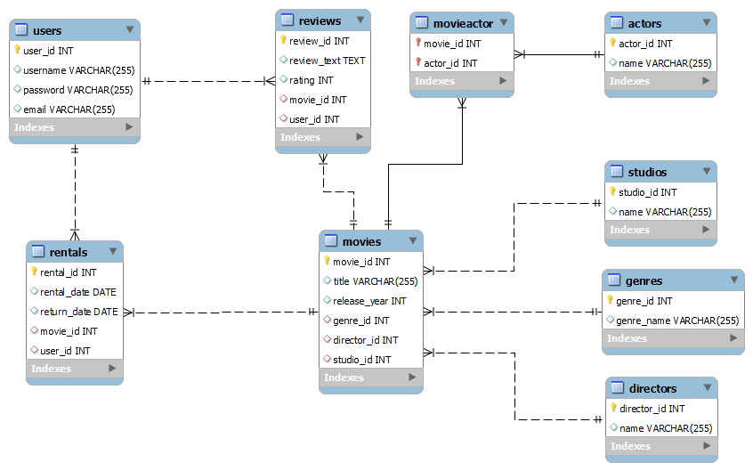
Schema

